Slide 1
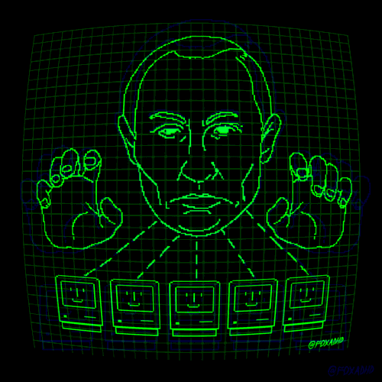
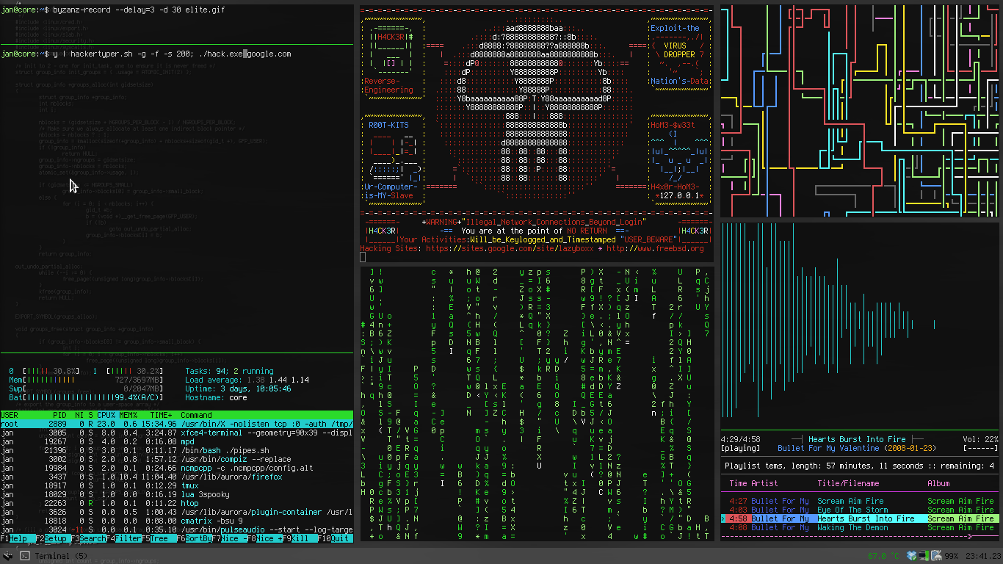
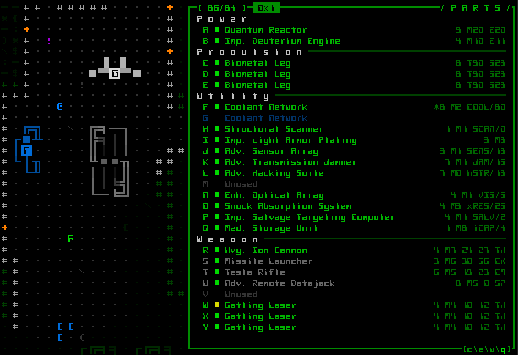
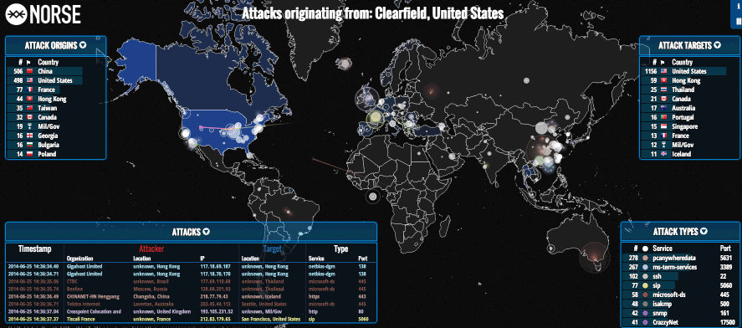
OPSEC
a Guide to “Operation Security”

Slide 2
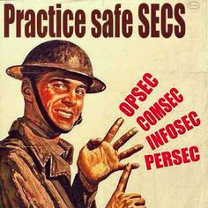
What is OPSEC ?
Operation Security (OPSEC) is a term originating in U.S. military jargon, as a process that identifies critical information to determine if friendly actions can be observed by enemy intelligence, determines if information obtained by adversaries.
Local Definition: achieving privacy, anonymity, and obscurity.

Slide 3
Things we will discuss;
Password Security (why it is important, how “hackers” obtain them)
Importance of SSL (how connections are intercepted and listened to)
Full disk Encryption (and how it is relevant to bypassing OS panel)
IP Security (implementing the TOR network on all applications)
Using BTC (a secure way for buying internet goods without being tracked)
OTR & XMPP (communicating with others with complete privacy)
Secure Emails (using secure email platforms compared to Hotmail, Yahoo)

Slide 4
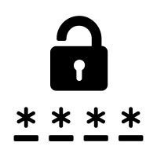
Password Security
Do you use the same password across all your accounts?
How frequently do you change your password?
Have you ever had any of your accounts compromised?
Do you memorize all your passwords?
haveIbeenpwned.com KeePassX

Slide 5
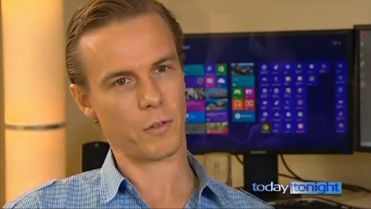
HaveIBeenPwned.com
Created by Microsoft dev Troy Hunt
Information Security blogger, website designed to pull database entries based on the email entered into the system. Website contains an archive of most public database breaches (like dropbox, linkedIn, adobe). Troy Hunt also claims only emails are listed on the website, not passwords or any of the sensitive info.

Slide 6
KeePassX
Goto: keepassx.org/downloads
Click on correct Operating System
Once downloaded run the program
Click on “Database” then “New Database”
Features: Automation, Offline, Entropies, Secure Password Generator

Slide 7
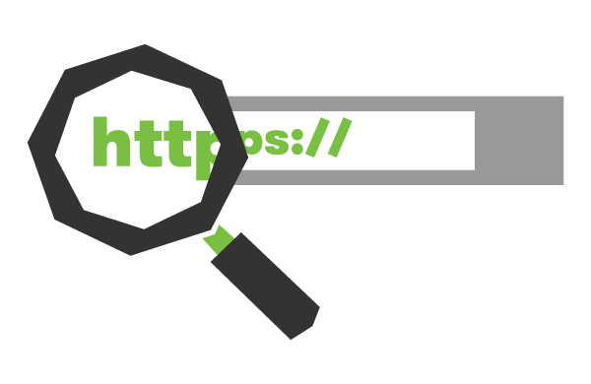
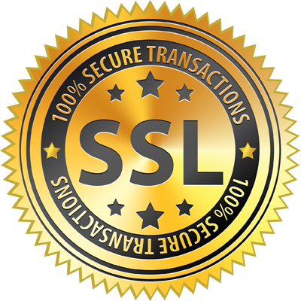
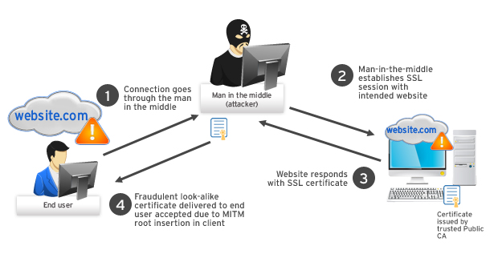
Importance of SSL
SSL encrypts everything between the
Browser and webserver. It protects
you from many vectors such as
MITM attacks (Man-In-The-Middle)
Some attacks like “sslstrip” intercept
connections and force users off SSL
leaving them vulnerable to attack.
It is important to maintain constant
SSL (HTTPS) among every site visited.

Slide 8
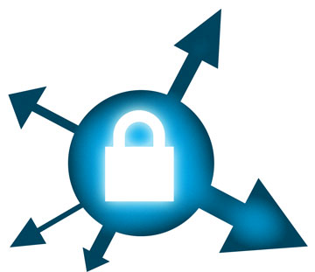
HTTPS Everywhere
HTTPS Everywhere is an extension created by EFF and the Tor Project which automatically switches thousands of sites from insecure “http” to secure “https”. It will protect you against many forms of surveillance and account hijacking, and some forms of censorship.
For more Information: https://www.eff.org/https-everywhere
This browser extension eliminates the MITM attack vector, allowing you to safely input passwords, banking info, etc. without worrying whether or not your connection is being intercepted and viewed upon.

Slide 9
Full disk Encryption + OS bypassing
OS bypassing (not official term) : the ability to view files and directories on a hard drive without bypassing or entering the necessary password presented inside an Operating System’s lockscreen.
How it is achieved: Simply mounting the target hard drive as if it were a USB on a different Operating System (preferably linux) allows all files to be viewed, moved, copied, and modified.
Encrypting your entire hard drive will prevent this from happening, and grants you absolute protection from thieves, friends, even government agencies like the NSA if they were to target you for whatever reason [no need to discuss why ;) ]

Slide 10
TrueCrypt
TrueCrypt is your best solution when it comes to encrypting your entire hard drive. It has a entropy feature, supports industry grade encryption like AES algorithms. It has also been audited many times by some of the top security firms. http://truecrypt.sourceforge.net/
However, TrueCrypt is outdated and no longer supported.
The developers have disappeared and no one knows why. Some conspiracy theorist claim they were extorted by the NSA for making their job more difficult.
Many people use TrueCrypt including cybercriminals that often enough are considered not guilty since their hard drives were encrypted; Thus, granting a “lack of evidence” when it comes to retrieving the data stored on their drives.

Slide 11
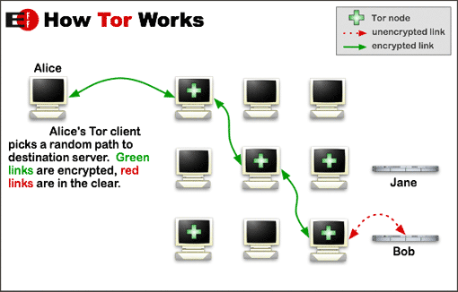
IP Security + TOR Infrastructure + I2P Network
An IP (Internet Protocol) is a set of numbers (varies between IPv4, IPv6) that contains your geographical location, ISP information, and the “gateway” to you. It is the way you receive data from other machines all across the internet.
TOR (The Onion Router) takes your connection
and routes it through different relay nodes
and then to your destination not just straight
across. It also provides a layer of encryption.
This allows you to do virtually anything you want
on the internet without getting traced back.

Slide 12
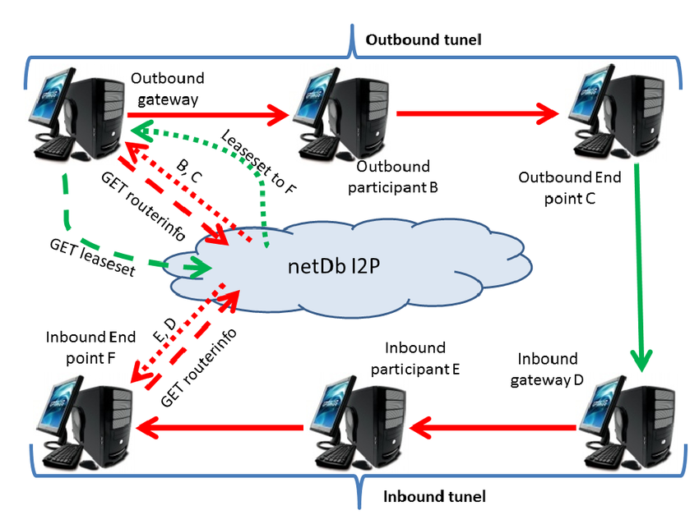
I2P Network
I2P is rather similar to TOR but with a twist.
TOR as a “bonus” function allows you to visit
.onion sites. These are sites with the domain
like this “testwffiokotmas.onion”. I2P does the
same thing but access to .i2p domains only. The
Purpose of I2P is to grant you a secure gateway
to just its own library of sites like test.i2p for
Markets, chatrooms, etc. TOR allows both
regular sites (.com .net) and .onion sites.
This is your gateway to the spooky “darknet”

Slide 13
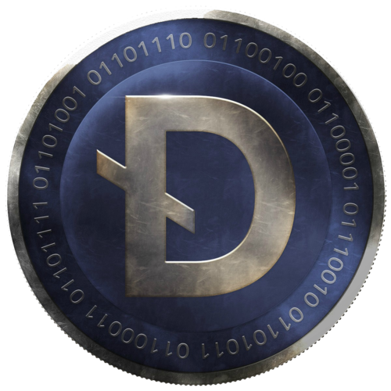
Using BTC as a Payment
Bitcoin is a powerful tool to use. Making payments online has always been a hassle. Using your credit card is always risky when it comes to online shopping. Paypal requires too much information to make it functional for you. Prepaid cards are annoying to transfer if let’s say you want it for something else. Bitcoin is your solution.
Bitcoin lives off of Blockchain (blockchain.info). It is “cryptocurrency”: a type of currency backed by algorithms and mathematical proportions thus it cannot be hacked, it cannot be replicated.
It has value, and its every increasing! (current rate: 1BTC ~ $ 920 USD)
The best part about bitcoin is that it’s private, granting you anonymity on what you buy. There are no names, SSN, etc. required to use bitcoin. Not even an email (depending on your wallet).

Slide 14
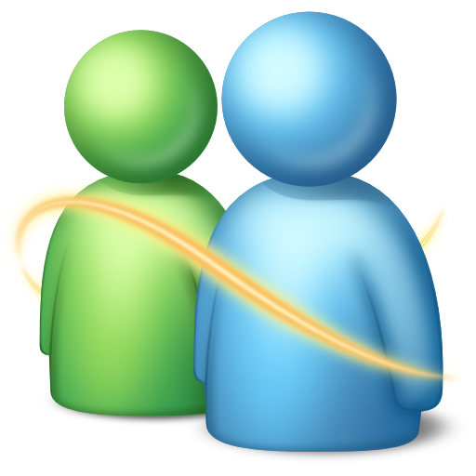
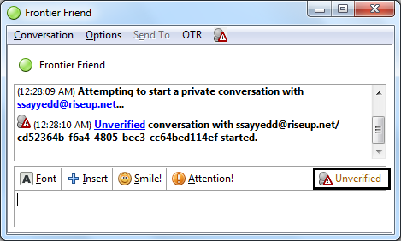
OTR & XMPP
XMPP is a protocol intended for IM or
Instant Messaging. It is used widely among
many people and has been around since ‘99.
(It used to be known originally as Jabber)
OTR stands for “off the record” and basically
encrypts your conversation (end-to-end) so
That your network provider, government,
not even your XMPP provider (like riseup.net)
can see what you’re saying.
Download: otr.cypherpunks.ca

Slide 15
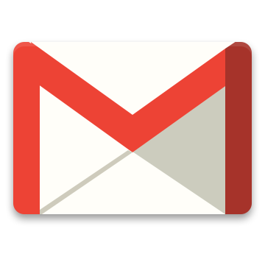
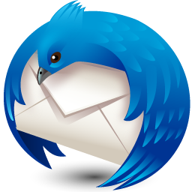
Secure Email Providers
Your email account is probably the most important entity that compiles as a part of your internet identity. Everything (mostly) is connected to your email and if it is ever compromised, the perpetrator has access to everything. Your social media, bank, medical, etc. accounts.
Keeping a secure email provider is important. Companies like google who provided gmail is good enough but not bulletproof when it comes to law enforcement / government requests.
ProtonMail is the world’s leading platform when it comes to security. It encrypts your emails thus making it completely useless for those who do not have the decryption key. Nobody can hack or decypher your account not even the developers.
Go grab an account here: Protonmail.com

Slide 16
</end>
We’ve talked about implementing many technologies to keep you safe online from any threat. Here is where I tell you that no piece of software can fully protect you from all the threats out there. There are always 0day exploits that will crack your anonymity. Think of it this way, wearing a helmet won’t protect you from everything, but sometimes it saves lives.
With that said I’d like to also say use such technologies for good not evil.
<insert_quote> With great power comes great responsibility </insert_quote>

